Slide 1


Slide 2
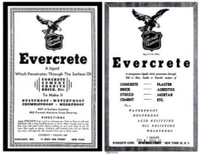

Evercrete Background
1942 | Established Head Office in New York, U.S.A. All products originate from the USA and have Government approvals.
1996 | Established Asia Pacific Office in Hong Kong.
1998 | Entered Asian region with distribution in Singapore, Malaysia, P. R. China, Taiwan, Philippines, India, Vietnam and Korea etc..
2004 | Entered Middle East-distribution started in U.A.E., Iran and Iraq. Exhibited in Big 5, Dubai and Roadex, Abu Dhabi.

Slide 3
Evercrete Milestone
2008 | Evercrete joins as member of the United States Green Building Council.
2011 | Creating a New Range of Products: the Cementitious. Extended the Middle East presence with a master distributor in Lebanon.
2013 | Entered the South American market through Brazil.
2014 | Established Evercrete’s Asia Offices in India and Philippines.

Slide 4


Test Report
Approved, Tested and Used by:
AASHTO American Association of State Highway and Transportation Officials
ASTM American Standard of Testing Materials
BSI British Standard Institution
WHO World Health Organization
VDOT Virginia Department of Transportation
HYD Hong Kong Highways Department Bridges and Structures Division
DMRC Delhi Metro Rail Corporation

Slide 5
What is Concrete Deterioration?
Notes:
5

Slide 6
What is Concrete Deterioration?
Concrete Deterioration
Concrete Deterioration occurs when it is exposed to weather, water or chemicals over an extended period of time. Deterioration can result in loss of strength and create unsafe conditions.
Salt
Chloride
Acid
Water
Notes:
6

Slide 7
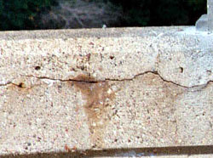
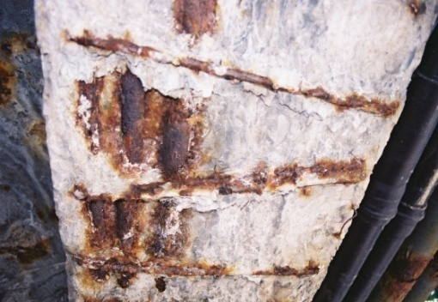
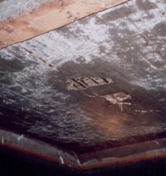
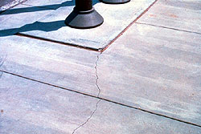
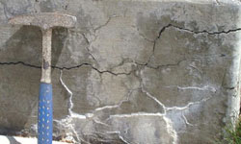
What is Concrete Deterioration?
Concrete Deterioration
As a result of concrete deterioration, the concrete slabs or concrete structures (your investment / properties) become as illustrated below-
Notes:
7

Slide 8
Factors causing Concrete Deterioration
Notes:
8

Slide 9
Factors causing Concrete Deterioration?
The following factors cause Concrete Deterioration:
1. Alkali Silica Reaction
2. Acid Attack
3. Carbonation
4. Freeze / Thaw Action
5. Water Leakage
Notes:
9

Slide 10
Factors causing Concrete Deterioration?
The following are the main factors causing Concrete Deterioration:
1. Alkali Silica Reaction
2. Acid Attack
3. Carbonation
The above 3 factors happen due the presence of Calcium Hydroxide – Ca(OH)₂ inside the concrete (cement)
Notes:
10

Slide 11
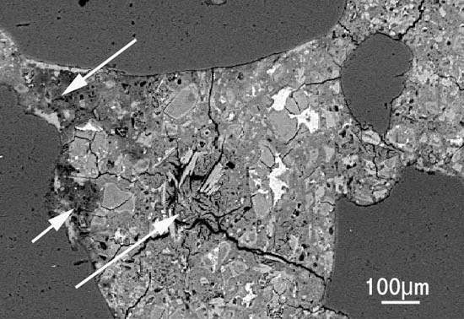
CAUSES & EFFECTS OF ASR- ALKALI SILICA REACTION IN CONCRETE
Hydroxyl ions in the alkaline cement pores in the concrete react
with reactive silica in the aggregates (e.g. chert, quartzite, opal, strained
Quartz crystals).
A gel is produced which increases in volume by absorbing water & hence exerts
an expansive pressure.
Result : Serious Expansion & Cracking in the concrete
In concrete without reinforcement ASR causes characteristic “MAP CRACKING”

Slide 12
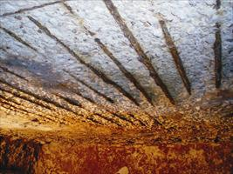

EFFECTS OF SALTS, ACIDS & CHLORIDES ON CONCRETE
Portland Cement, the “binding” component in concrete
(other components being aggregates & Water) has a PH approaching 12 which makes it
very alkaline.
In order for the cement to hold together the other components, it is
important for it to remain at or near a PH of 12
When salt(PH of roughly 6-7) , other acids, such as acid rain etc, are introduced
onto the concrete, they enter the small pores & micro
cracks of the concrete & attack the surrounding materials,
lowering their PH.
As the PH is lowered, the cement’s ability to hold things is
compromised.
Results : Exposed to acidic environments for a long
period of time-all that will be left will be sand & grit.

Slide 13
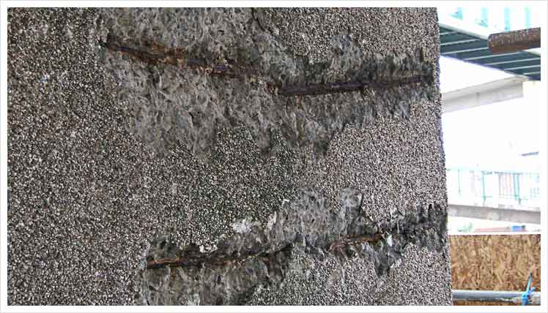
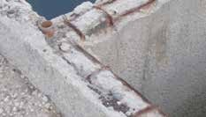
EFFECTS OF CARBONATION ON CONCRETE
Carbonation is a reaction between the cement in concrete & carbon dioxide in the air.
Carbonation progressively lowers the PH in concrete, though the process is somewhat slow(about 6 years to progress 50mm or 2 inches)
Result: When carbonation(lowered PH) reaches the level of steel reinforcement, it attacks the thin protective layers of iron oxide surrounding the reinforcement & initiates corrosion. Since steel can expand 6 times its size when corroded, resulting pressure causes the surrounding concrete to crack & break.
In Structural Concrete, this can result in Structural failure.

Slide 14
Factors causing Concrete Deterioration?
The following factors also cause Concrete Deterioration:
4. Freeze / Thaw Action
5. Water Leakage
The above 2 factors happen because the water molecules penetrate into the concrete through unseen small voids / pores.
Notes:
14

Slide 15
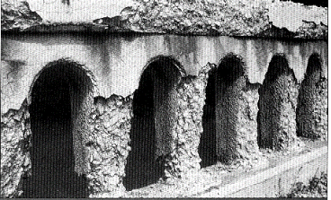
EFFECTS OF FREEZE/THAW ON CONCRETE
Deterioration of concrete from freeze /thaw occurs when
the concrete is Critically Saturated (91% )of its pores are filled with water.
When H₂O freezes to ice it occupies 9% more volume than that of water.
If there is no space for this volume expansion in a porous, water containing
material like concrete, freezing causes distress in the concrete.
Result: The Critically Saturated distressed concrete from freezing & thawing.
From its first cycle & through successive winter seasons, it results in repeated
loss of concrete surface.

Slide 16
Evercrete Product & Solution
Notes:
16

Slide 17
EVERCRETE DEEP PENETRATING SEALER (DPS)
Evercrete DPS is an environmentally friendly, non-toxic, non-flammable, odorless,
clear, water-soluble liquid compound which is safe and easy to use.
Evercrete DPS outlasts and outperforms every other sealant available today.
It is inorganic and based on natural minerals, affecting neither your health nor the
environment. Evercrete DPS can be stored for extended periods.

Slide 18

Evercrete Deep Penetrating Sealer
How Does It Work?
When sprayed onto hardened concrete, Evercrete DPS penetrates the surface to become an integral part of the concrete by chemically reacting with the calcium hydroxide (CaOH2) or sodium & potassium present in the concrete to form sodium silicate hydrate, which has both cementing and waterproofing properties. A non-soluble seal is formed within the pores and capillaries of the concrete, permanently sealing it against the ingress of moisture yet allowing the concrete to breath.
The Evercrete DPS reaction takes place below the concrete surface and does therefore not affect the concrete’s natural characteristics.
2 – 3 cm

Slide 19
Evercrete Deep Penetrating Sealer
How Does It Work?
Salt
Chloride
Acid
Water
2 – 3 cm
Notes:
19

Slide 20
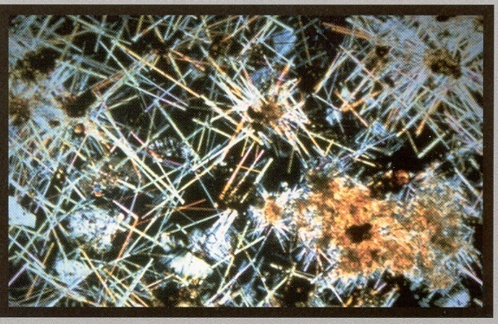
Evercrete Deep Penetrating Sealer
Voids in the microstructure of hydrated cement
that can be sealed using Deep Penetrating Sealer
Scale: 1:5000mm

Slide 21
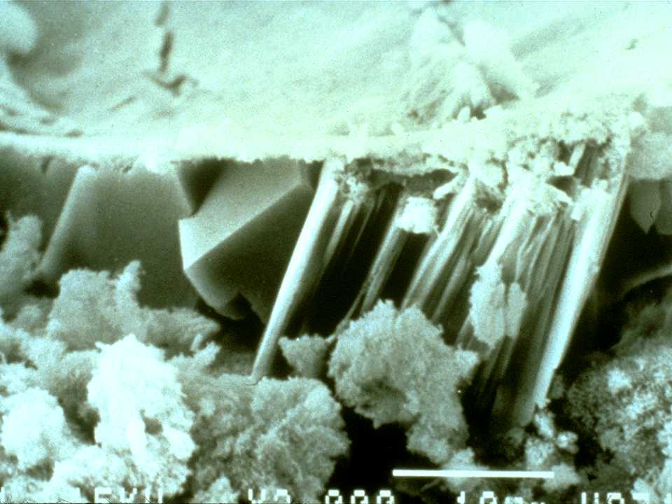
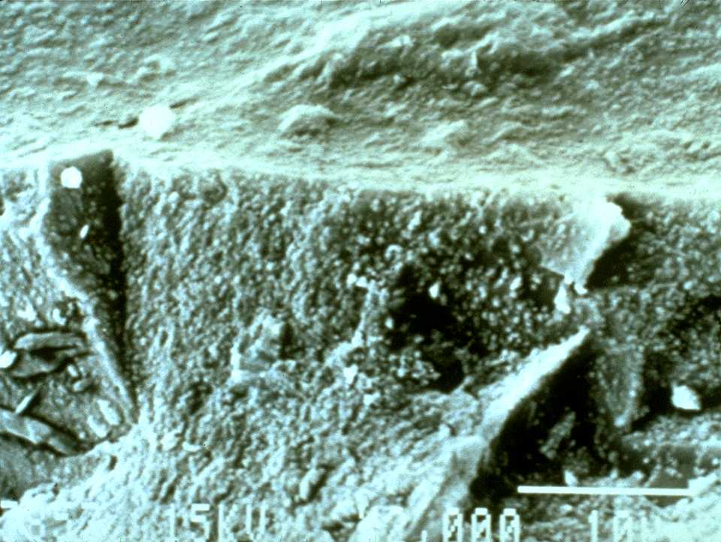
Evercrete DPS: Physical Effect
Untreated Concrete
Treated with Evercrete DPS
The presence of any type of very small particles will improve concrete properties. This effect is termed either “particle packing” or “micro filling”.

Slide 22
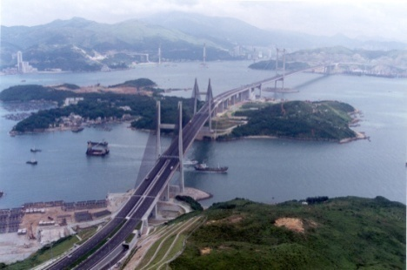
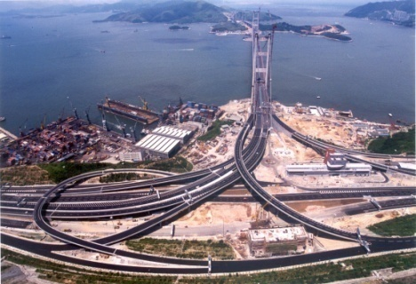
Evercrete Deep Penetrating Sealer
Approved by American Association of State Highway
and Transportation Officials (AASHTO)
Determination of Water Absorption in accordance with AASHTO TP50-95
Results:
Concrete treated with Evercrete DPS Concrete Sealer, achieved an AASHTO category "Good Sealer", when tested in accordance with AASHTO Designation TP50-95. "Good Sealer" being the top classification for best performance for a waterproofing sealer.

Slide 23
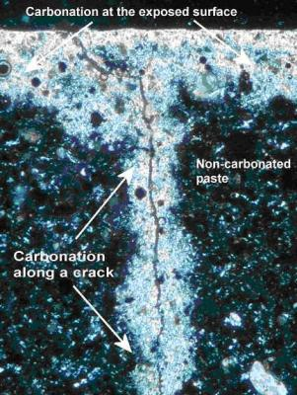
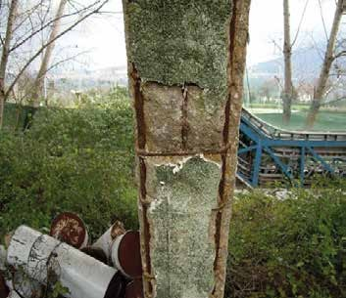
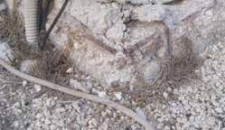

Resistance Carbonation
Carbonation occurs when carbon dioxide (CO2) from the air penetrates the concrete and reacts with hydroxides, to form carbonates. Due to this reaction, it reduces the PH of the concrete to as low as PH7.5 At this level, the passive film on the steel is not stable or destroyed. Therefore, corrosion occurs. Carbonation also results in micro-cracks which provides opportunities for CO2, moisture and salt to penetrate deeper into the concrete, leading to corrosion of steel reinforcement which is a common cause of degradation of concrete structures.
Tested in accordance with BS EN 13295 | Untreated Concrete | Concrete treated with DPS
Depth of Carbonation (0 day) | <0.5mm | <0.5mm
Depth of Carbonation (56 days) | 0.9mm | <0.5mm
Tested in accordance with BS EN 13295,concrete treated with Evercrete DPS
provides an excellent resistance against carbonation and as such is approved as an
anti-carbonation coating.
Notes:
23

Slide 24
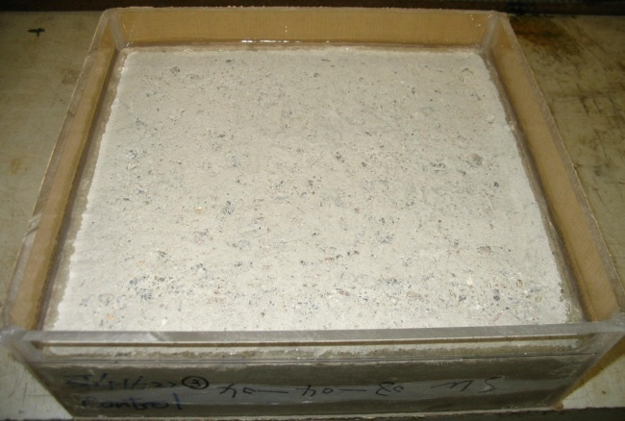
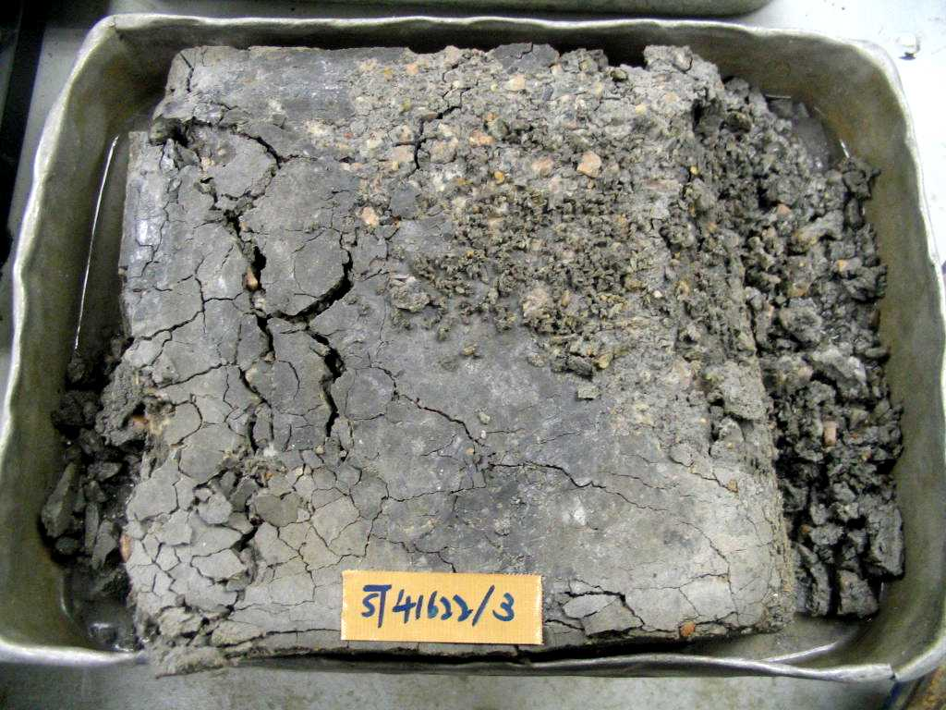

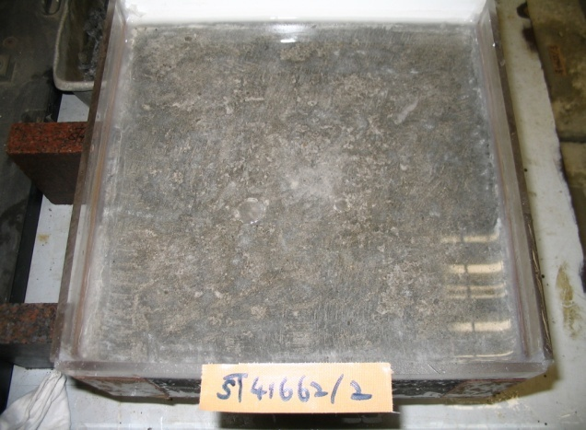
Resistance To Freeze/Thaw & De-icing Chemicals,
Marine Salts and Chloride Ion Ingress
Tested in accordance with ASTM C672/C 672N-03 (600 hours)
Untreated
Treated with
Evercrete DPS

Slide 25
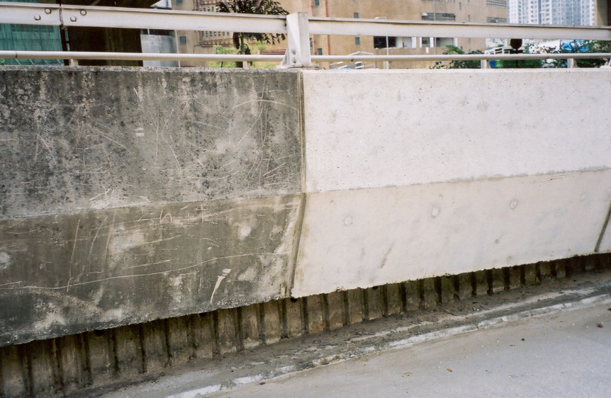
Waterproof Concrete
The Key to Long Term Concrete Durability
Treated Concrete –
Remains clean and white after the application of Evercrete range products such as Deep Clean, DPS and Top Seal.
Untreated Concrete –
Mould & algae rapidly returned to the cleaned concrete because of the lower surface PH.

Slide 26
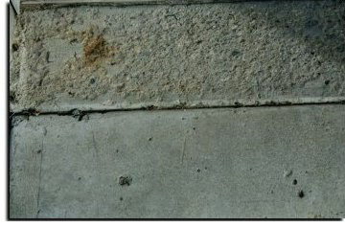
Concrete Stabilizer & Preserver
The Key to Long Term Concrete Durability
Untreated Concrete
Treated with Evercrete DPS
This picture is of a carwash entrance. After 14 years of countless freeze and thaw cycles,continuous water contact and abrasion the treated concrete (bottom) still looks new compared to the untreated concrete (top).

Slide 27
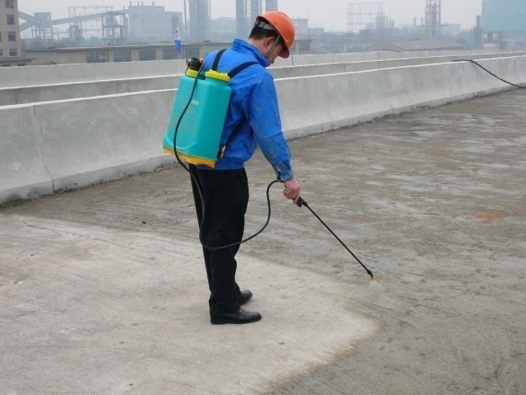
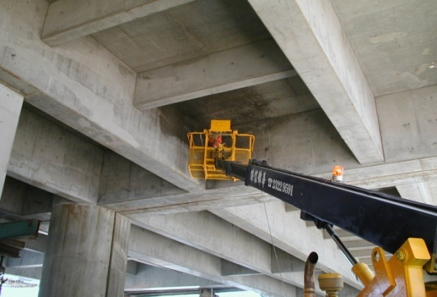
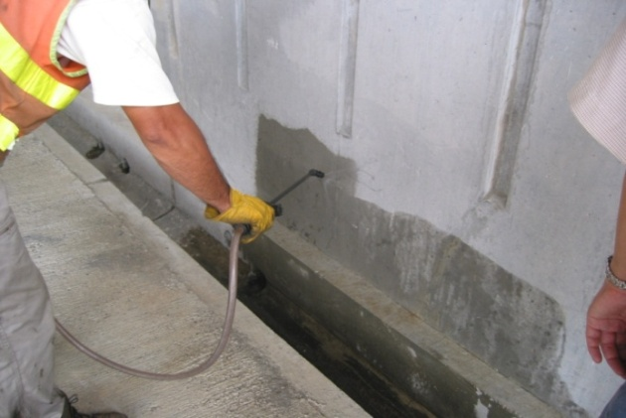
Evercrete Deep Penetrating Sealer(DPS)
Application procedure:
Concrete to be free of oil, grease and dust
Shake well before use
Pre-wet the concrete
Spray apply first and second coat, for larger areas use a mechanical sprayer
For walls apply from the bottom up, on floors spray to obtain a wet look
Apply the second coat after 24 hours
Wait 7 days before covering with paint or tiles
Application on the Highways
Application by mechanical sprayer
Application on the Wall

Slide 28
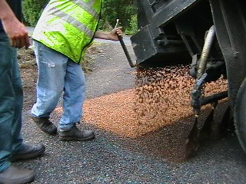
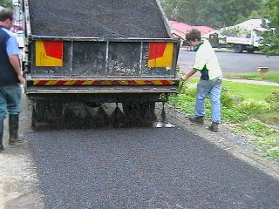
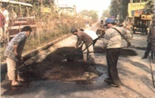
Evercrete Deep Penetrating Sealer
Product Advantages
Concrete Preserver and Water-proofer
Non-Toxic
Seals hairline cracks up to 0.3mm
Resists Salt; Acid; Chloride; UV
Increases Compressive Strength
Dusting resistant
Floor Hardener
An integral part of the concrete
Allows concrete to breathe
Acts as a curing agent
Applied to wet/damp surfaces
ONE step application
ONE time application. Future recoating is not required.
Approved by WHO for portable water tanks.
Notes:
Go over with louisa re compared to leonorah’

Slide 29
LIMITATIONS OF PLASTER OVER EVERCRETE DPS
It is porous in nature.
Doe not resist Acid attacks , salt, chlorine or other contaminants present in water to be treated.
Deteriorates when exposed continuously to contaminated water.
When exposed to water/moisture, it will allow growth of algae and fungus on the surface.
It is not a one time treatment.
It’s more than double the cost of Evercrete DPS.
It is tedious and requires extensive manpower-hence increasing costing.
It requires water curing, whereas DPS is a self curing compound.

Slide 30

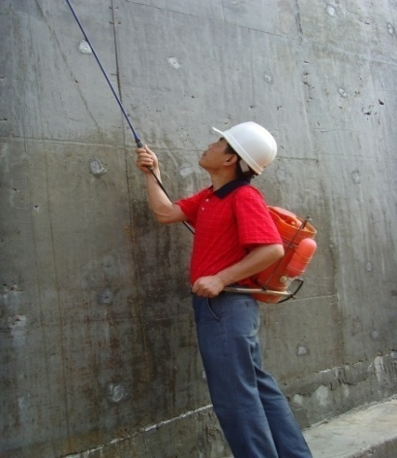
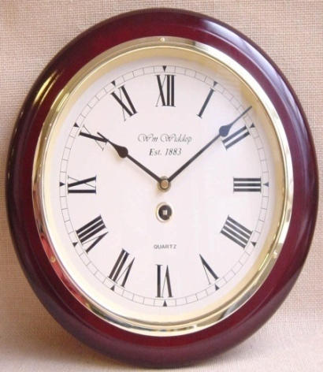
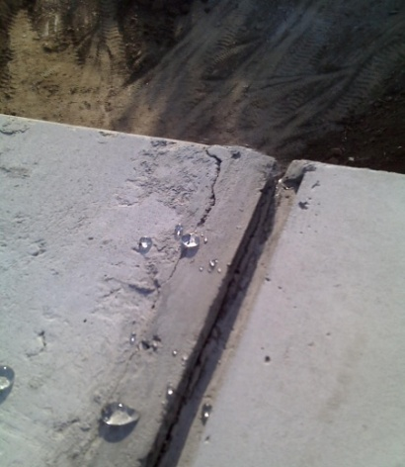
Evercrete Deep Penetrating Sealer(DPS)
Cost Advantages
1. Material Cost
2. Labour Cost
Competitive price
No special training required
Saves maintenance cost
No special machine required
Daily working rate: 1,000m² / worker
3. Time
4. Finishing
Can apply on dry / damp surfaces
No primer required for
surface furnishing
Can apply after 72 hours of
casting concrete
The applied area can stand alone
without any protective layer
Notes:
30
Go over with louisa re compared to leonorah’

Slide 31
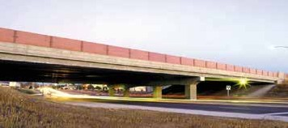
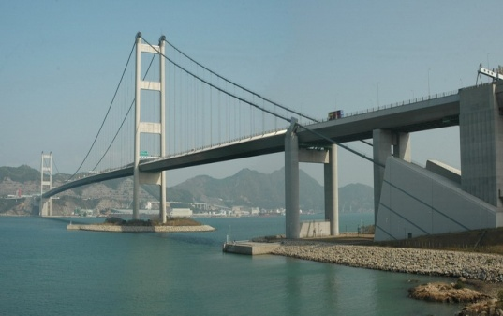

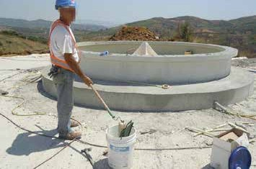
Evercrete Deep Penetrating Sealer(DPS)
is recommended for …..
Highway Bridge Decks and Highway Structures
High rise columns and parapets
All types of concrete flooring
External and Internal Concrete walls
Bathroom floors
Food processing plants
Water tanks and reservoirs
Parking structures
Chemical factories
Fuel station forecourts
Sewerage treatment plants

Slide 32
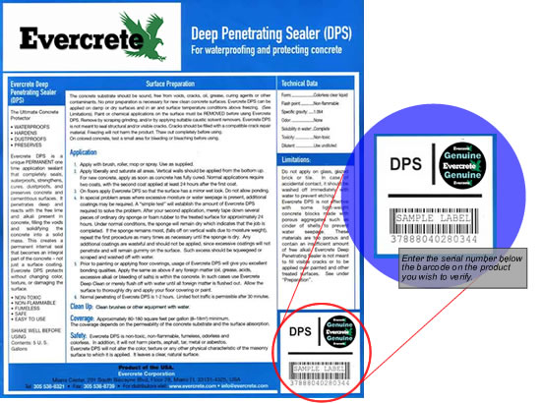
Current Products Security
Each and every product manufactured by Evercrete Corp. USA will have a unique barcode and hologram located on the bottom right hand corner.
The barcode number can be verified by going to www.evercrete.com - product security
Notes:
32

Slide 33
You can find us
Evercrete Corporation USA
Miami Centre,201 South Biscayne Blvd, Floor 28, Miami Fl 33131-4325,USA
Tel: + 305 538 8321
Fax: + 305 538 8739
M: +852 92366080
Email: info@evercrete.com , marketing.india@evercrete.com
Website: www.evercrete.com
ACE LEAKAGE SOLUTIONS
(OUR STOCKIST AND BUSINESS ASSOCIATES IN INDIA)
Plot No.11, Basement, Satyam Enclave, Main GT Road, Prakash Industrial Estate, Sahibabad, Ghaziabad -201005
Tel: 0120-4354412
M: +91-9650575756
Email: vivek@aceleakage.com

